Slide 1
Strings

Slide 2
Credits
Some of the contents of this slide presentation have been referenced and reproduced from the textbook for this course, PHP Programming with MySQL (Second Edition) , Don Gosseling, Diana Kokoska, and Robert Easterbrooks, ©2011, Cengage Learning, All Rights Reserved. ISBN 978-0-5387-4584-0.
Thank you for some references to Kevin Skoglund, from PHP with MySQL Essential Training (2013), ©2017 LinkedIn Corporation.

Slide 3
LEARNING OBJECTIVES
Construct text strings
Work with single strings
Work with multiple strings and parse strings
Compare strings
Use regular expressions

Slide 4
Construct Text Strings
String Overview
Strings are an extremely important data type to PHP
PHP is often used to perform form processing
All form data is stored by HTML in strings
Form data is submitted in string format

Slide 5
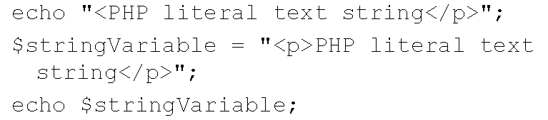
Construct Text Strings
String Characteristics
A text string contains zero or more characters surrounded by double or single quotation marks
Best Practice is double quotes unless embedding strings or displaying variable names
Text strings can be used as literal values or assigned to a variable

Slide 6

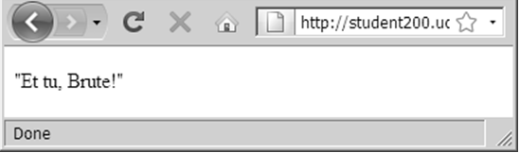
Construct Text Strings
Delimiting Strings
A string must begin and end with a matching quotation mark (single or double)
Strings embedded within strings
A quoted string within a literal string delimited by double quotes is delimited with single quotes
A quoted string within a literal string delimited by single quotes marks is delimited with double quotes

Slide 7
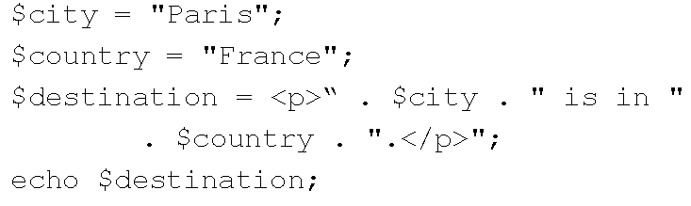
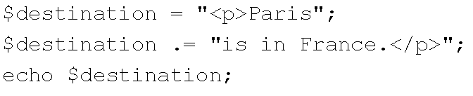
Construct Text Strings
String Operators
Concatenation operator ( . ) combines two strings
Concatenation assignment operator ( . ) combines two strings and assigns the new value to a variable

Slide 8
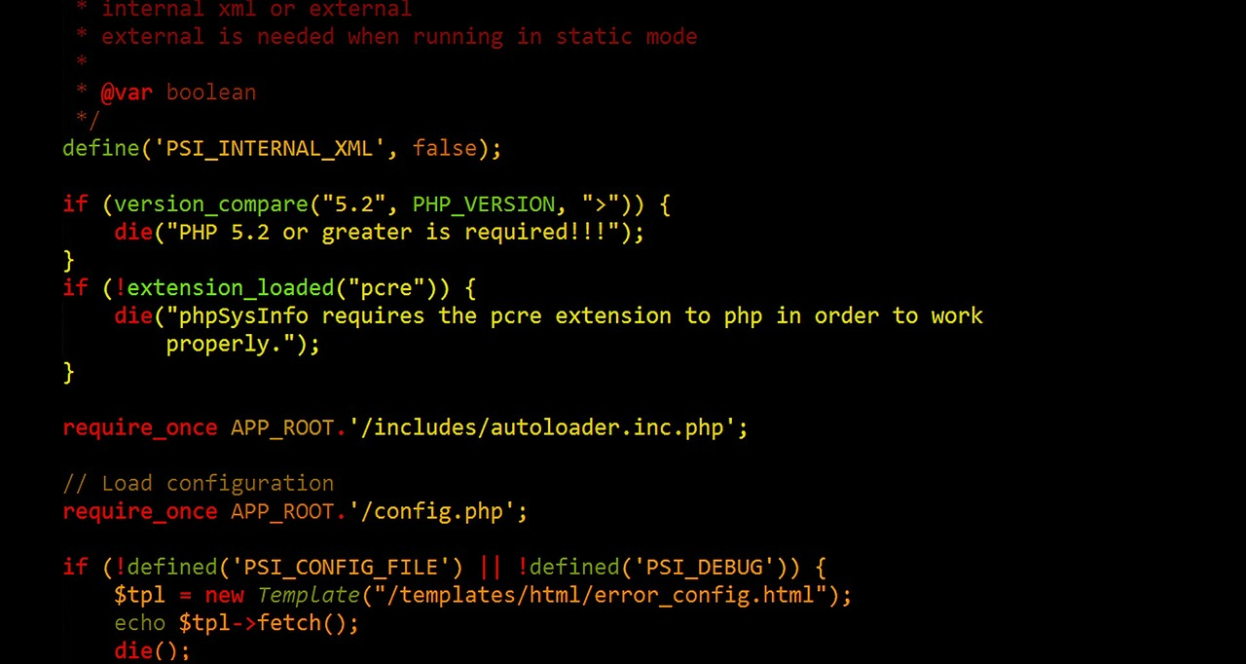
Construct Text Strings
Programming Exercise 02_03_01 – Step 1
Working with String Operators

Slide 9
Construct Text Strings
Escape Sequences
An escape character tells the compiler or interpreter that the character that follows it has a special purpose
In PHP the escape character is the backslash ( \ ) echo ’<p>This code\’s working</p>’;
Do not use backslash before an apostrophe in a text string delimited with double quotation marks echo ”<p>This code’s working</p>”;

Slide 10
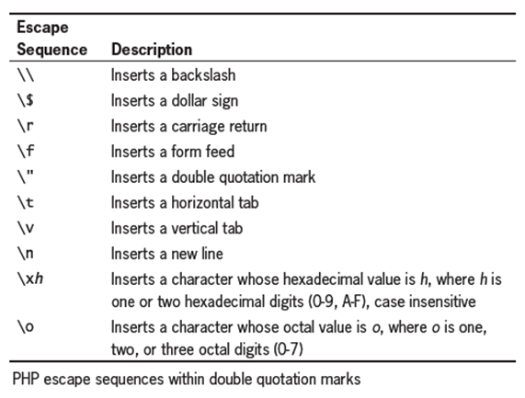
Construct Text Strings
Escape Sequences
The escape character combined with one or more other characters is an escape sequence

Slide 11
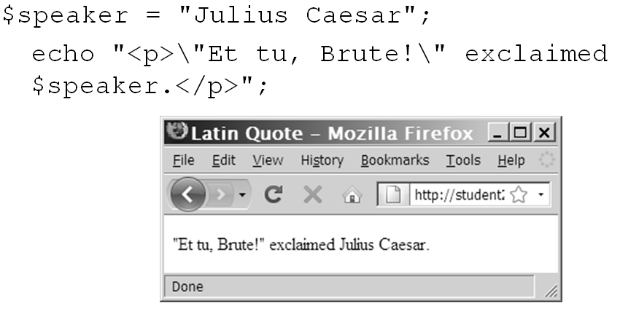
Construct Text Strings
Escape Sequences

Slide 12
Construct Text Strings
Programming Exercise 02_03_01 – Step 2
Using Escape Sequences

Slide 13


Construct Text Strings
Simple & Complex String Syntax
Simple string syntax uses the value of a variable embedded in a string with double quotation marks
Complex string syntax is when variables are placed within curly braces inside of a string

Slide 14
Construct Text Strings
Programming Exercise 02_03_01 – Step 3
Simple & Complex String Syntax

Slide 15
Work With Single Strings
String Functions
PHP provides a number of functions for analyzing, altering, and parsing text strings
Unlike JavaScript, which implements its string utilities as methods of string objects
The functionality provided is quite expansive, some examples:
Counting characters and words
Transposing and converting strings
Changing the case of text within a string

Slide 16
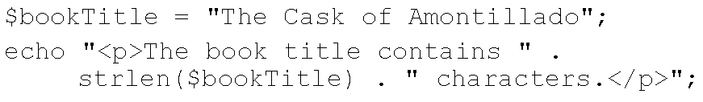
Work With Single Strings
Counting Characters in a String
The most commonly used string counting function is the strlen() function
Returns the total number of characters in a string
Escape sequences, such as \n, are counted as one character

Slide 17
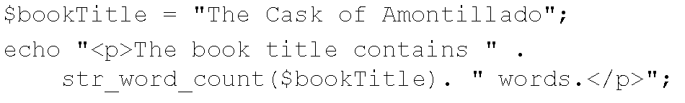
Work With Single Strings
Counting Words in a String
The str_word_count()function the total number of words in a string

Slide 18
Work With Single Strings
Programming Exercise 02_03_01 – Step 4
Counting Characters and Words in a String

Slide 19
Work With Single Strings
Modifying the Case of a String
PHP provides a number of functions to manipulate the case of a string
The strtoupper()function converts all letters in a string to uppercase
The strtolower()function converts all letters in a string to lowercase
The ucfirst()function ensures that the first character of a word is uppercase
The lcfirst()function ensures that the first character of a word is lowercase

Slide 20
Work With Single Strings
Modifying the Case of a String
The ucwords()function changes the first character of each word
Use the strtolower()function on a string before using the ucfirst()and ucwords() to ensure that the remaining characters in a string are in lowercase
Use the strtoupper()function on a string before using the ucfirst() and ucwords() to ensure that the remaining characters in a string are in uppercase

Slide 21
Work With Single Strings
Programming Exercise 02_03_01 – Step 5
Modifying the Case of a String

Slide 22
Work With Single Strings
Encoding and Decoding a String
Some characters in HTML have a special meaning and must be encoded using HTML entities in order to preserve that meaning
The htmlspecialchars()function converts special characters to HTML entities
The html_specialcharacters_decode() function converts HTML character entities into their equivalent characters

Slide 23
Work With Single Strings
Encoding and Decoding a String
The characters that are converted with the htmlspecialchars()function are:
'<' (less than) becomes '&lt; '
'>' (greater than) becomes '&gt; '
'&' (ampersand) becomes '&amp; '

Slide 24
Work With Single Strings
Encoding and Decoding a String
If ENT_QUOTES is enabled in the PHP configuration, both single and double quotes are converted
If ENT_QUOTES is disabled in the PHP configuration, neither single nor double quotes are converted
'"' (double quote) becomes '&quot; ' when ENT_NOQUOTES is disabled
''' (single quote) becomes '&#039;' only when ENT_QUOTES is enabled

Slide 25
Work With Single Strings
Encoding and Decoding a String
Storing passwords as plain text creates security and privacy issues
The md5()function uses a strong encryption algorithm to create a one-way hash
It does not have an equivalent decode function
Makes it useful for storing passwords in a database
The user’s entered password is passed to the function and the resulting value is compared to the stored value

Slide 26
Work With Single Strings
Other Ways to Manipulate a String
PHP provides three functions that remove leading or trailing spaces in a string
trim()will strip (remove) leading or trailing spaces in a string
ltrim()removes only the leading spaces
rtrim()removes only the trailing spaces
The strrev()function reverses the order of the characters in a string
The str_shuffle()function randomly scrambles the order of the characters in a string

Slide 27
Work With Single Strings
Other Ways to Manipulate a String
The substr()function returns part of a string based on the start and length parameters substr(string, start, optional length);
A positive start parameter indicates how many characters to skip at the beginning of the string
A negative start parameter indicates how many characters to count in from the end of the string
A positive length parameter determines how many characters to return
A negative length parameter skips that many characters at the end of the string and returns the middle portion
If the length is omitted or is greater than the remaining length of the string, the entire remainder of the string is returned

Slide 28
Work With Single Strings
Programming Exercise 02_03_01 – Step 6
Other Ways to Manipulate a String

Slide 29
Work With Multiple Strings
Finding and Extracting Characters & Substrings
Parsing is the act of dividing a string into logical component substrings or tokens
Form submission to PHP requires much string manipulation
There are two types of string search and extraction functions
Functions that return a numeric position in a text string
Functions that return a character or substring
Both functions return a value of false if the search string is not found

Slide 30
Work With Multiple Strings
Finding and Extracting Characters & Substrings
The strpos()function performs a case-sensitive search
Returns the position of the first occurrence of one string in another string
Pass two arguments to the strpos()function:
The first argument is the string you want to search
The second argument contains the characters for which you want to search
If the search string is not found, the strpos() function returns a Boolean value of false

Slide 31
Work With Multiple Strings
Finding and Extracting Characters & Substrings
The strchr()and the strrchr() functions are passed the string and the character for which you want to search
Both functions return a substring from the specified characters to the end of the string
strchr() starts searching at the beginning of a string
strrchr() starts searching at the end of a string

Slide 32
Work With Multiple Strings
Programming Exercise 02_03_01 – Step 7
Finding and Extracting Characters & Substrings

Slide 33
Work With Multiple Strings
Replacing Characters & Substrings
The case-sensitive str_replace()and case-insensitive str_ireplace() functions
Both accept three arguments
The target string to search for
A replacement string
The string in which you want to replace characters
Neither function modifies the string, they return a new string

Slide 34
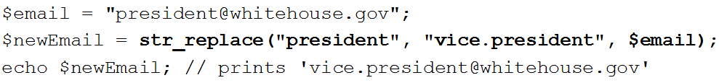
Work With Multiple Strings
Replacing Characters & Substrings
The substr_replace()replaces character only within a specified portion of a string
Both accept four arguments
The target string to search
A replacement string
The start and end positions of the target characters
No end argument replaces rest of string from start

Slide 35
Work With Multiple Strings
Programming Exercise 02_03_01 – Step 8
Replacing Characters & Substrings

Slide 36
Work With Multiple Strings
Dividing Strings into Smaller Pieces
A delimiter is a character or a string that is used to separate components
The strtok() function uses delimiters to break a string into smaller strings, called tokens
Syntax $variable = strtok(string, delimiters);

Slide 37
Work With Multiple Strings
Dividing Strings into Smaller Pieces
A delimiter is a character or a string that is used to separate components
The strtok()function uses delimiters to break a string into smaller strings, called tokens
Multiple delimiters can be used
Syntax $variable = strtok(string, delimiters);
This first call returns the first token up to a delimiter
The PHP engine remembers the current token
The following calls with just the delimiters return succeeding tokens $variable = strtok(delimiter);

Slide 38
Work With Multiple Strings
Programming Exercise 02_03_01 – Step 9
Dividing Strings into Smaller Pieces

Slide 39
Work With Multiple Strings
Programming Exercise 02_03_01 – Step 10
Dividing Strings into Smaller Pieces

Slide 40
Work With Multiple Strings
Converting Between Strings and Arrays
The str_split() and explode() functions split a string into an indexed array
The str_split() function splits each character in a string into an array element using the syntax $array = str_split(string[, length]);
The optional length argument is the number of characters to assign to each array element

Slide 41
Work With Multiple Strings
Converting Between Strings and Arrays
The explode() function splits a string into an indexed array at a specified separator
The syntax for the explode() function is: $array = explode(separators, string);
Differences from strtok()
The order of the arguments is reversed
Separators is treated as a single string delimiter, not separate delimiters
If the string does not contain the specified separators, the entire string is assigned to the first element of the array

Slide 42
Work With Multiple Strings
Programming Exercise 02_03_01 – Step 11
Converting Between Strings and Arrays

Slide 43
Work With Multiple Strings
String Comparison Operators
PHP comparison operators compare individual characters by their ASCII codes
This makes comparison operators case-sensitive
The == comparison operator is not safe for string comparisons
It can type cast a string into a number
String comparison functions should always be used for string comparisons

Slide 44
Work With Multiple Strings
Programming Exercise 02_03_01 – Step 12
String Comparison Operators

Slide 45
Work With Multiple Strings
String Comparison Functions
Comparison operators can have problems when used to compare strings
PHP comparison operators compare individual characters by their ASCII codes
This makes comparison operators case-sensitive
The == comparison operator is not safe for string comparisons
It can type cast a string into a number
String comparison functions should always be used for string comparisons

Slide 46
Work With Multiple Strings
String Comparison Functions
The strcmp()function performs a case-sensitive comparison of strings
The strcasecmp()function performs a case-insensitive comparison of strings
Both functions accept two arguments representing the strings you want to compare
Compare strings based on their ASCII values
Return values
0 : equal strings
< 0 : first string less than second
> 0 : first string greater than second

Slide 47
Work With Multiple Strings
String Similarity Functions
PHP provides functions that can determine the similarities, and the differences, between 2 strings
The similar_text()function returns the number of characters that two strings have in common
The levenshtein()function returns the number of characters that need to be changed for two strings to be the same

Slide 48
Work With Multiple Strings
Programming Exercise 02_03_01 – Step 13
String Comparison Functions

Slide 49
Use Regular Expressions
Regex
Regular expressions are patterns that are used for matching and manipulating strings according to specified rules
PHP supports PCRE, Perl Compatible Regular Expressions
Very often used for validating submitted form data

Slide 50
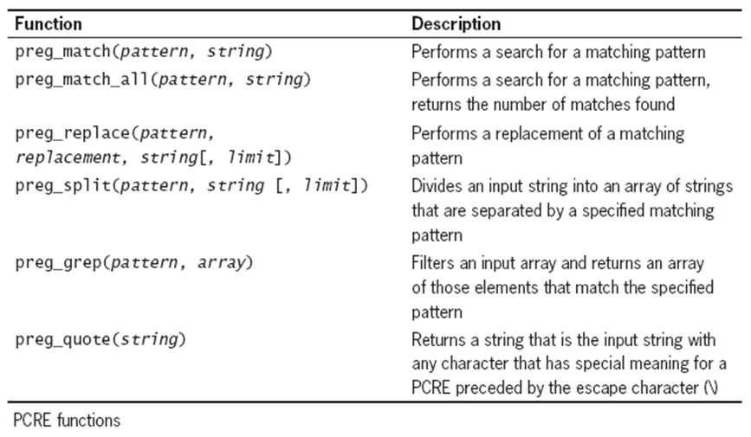
Use Regular Expressions
Regex
Most common PCRE function is preg_match() preg_match(pattern, string);
First argument is the regular expression pattern
Second argument is string to match against it

Slide 51
Use Regular Expressions
Regex
A regular expression pattern is a special text string that describes a search pattern
Regular expression patterns consist of literal characters and metacharacters
Special characters that define the pattern-matching rules
Regular expression patterns are enclosed in opening and closing delimiters
The most common character delimiter is the forward slash ( / )
We should be familiar with Regex for tests and certifications, but commonly they are Googled

Slide 52
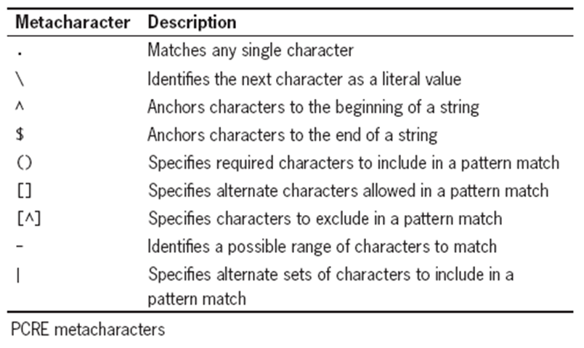
Use Regular Expressions
Regex

Slide 53
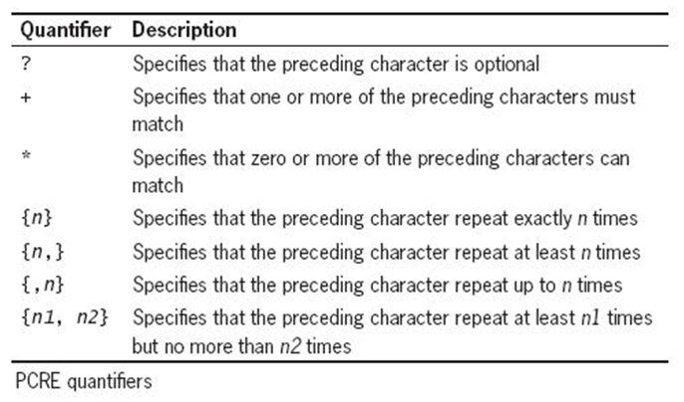
Use Regular Expressions
Regex
Metacharacters that specify the quantity of a match are called quantifiers

Slide 54
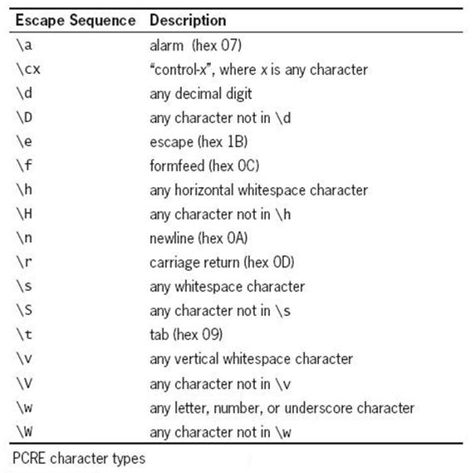
Use Regular Expressions
Regex
Escape sequences define valid character classes

Slide 55
Use Regular Expressions
Programming Exercise 02_03_01 – Step 14
Regular Expressions

